Slide 1

COMMUNITY TROUBLE SHOOTER
TEAM 155
SUPER SIX

Slide 2
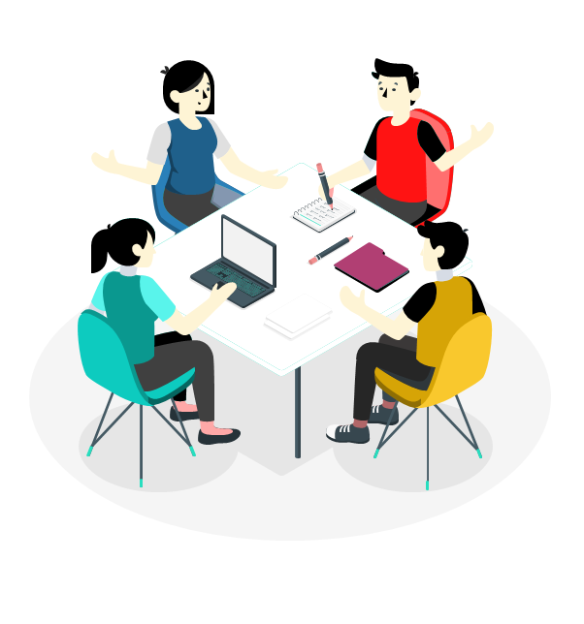
TEAM MEMBERS & ROLES
D. Lakshmi Bhavani – Team leader, Back end
D. Lohitha – Back end
Thumma Nuthna – Front end
Monica G – Front end
S. Harshita – Back end
Ramavath Manjula – Front end

Slide 3


PROBLEM STATEMENT
Enhancing Community Welfare through Integrated Departmental Problem Solving System.

Slide 4
PROBLEM STATEMENT
Our proactive system addresses community issues by allowing residents to submit concerns through a user-friendly platform.
The dynamic and adaptable system ensures prompt solutions across departments, and its managed expansion caters to evolving community needs.
This process showcases responsiveness, accountability, and maintains a record of timely issue resolutions.

Slide 5

COMMUNITY TROUBLE SHOOTER
Navigating Challenges, Building Communities : Empowering Solutions Across Departments

Slide 6


SOLUTION
Customers can upload images, enriching issue reporting.
Using sentiment analysis, this system can assess the emotional context of submitted content, aiding in more nuanced problem understanding.

Slide 7

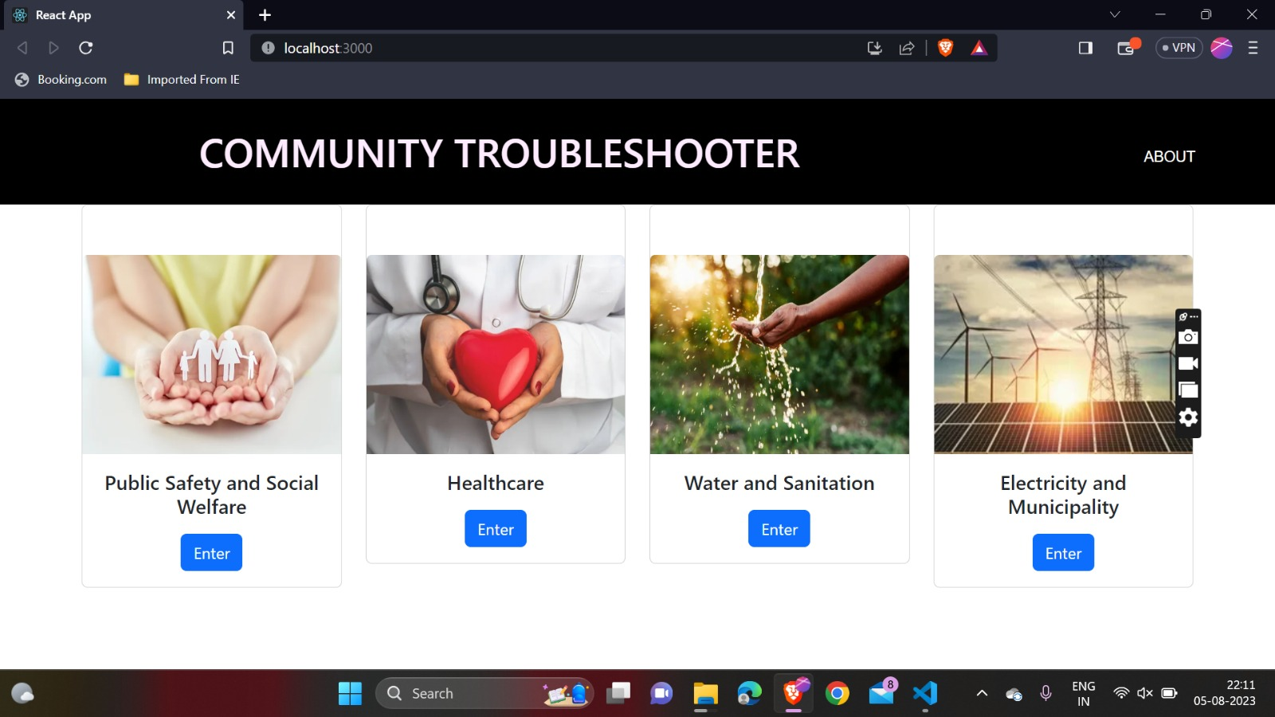

Slide 8
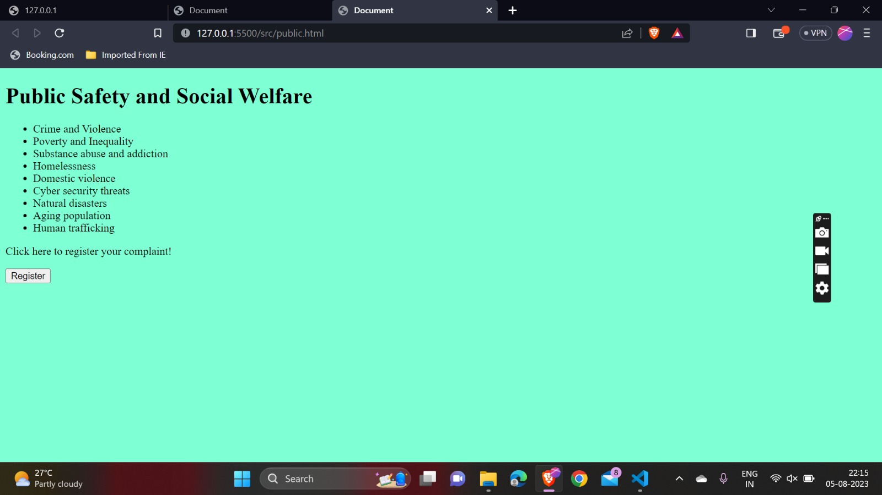
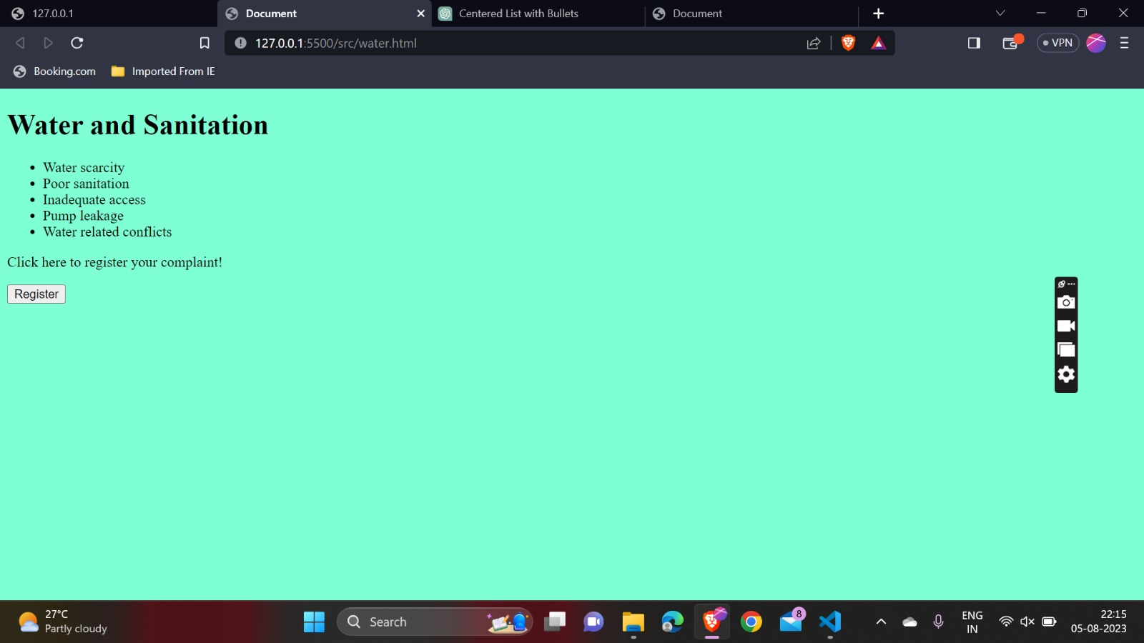

Slide 9
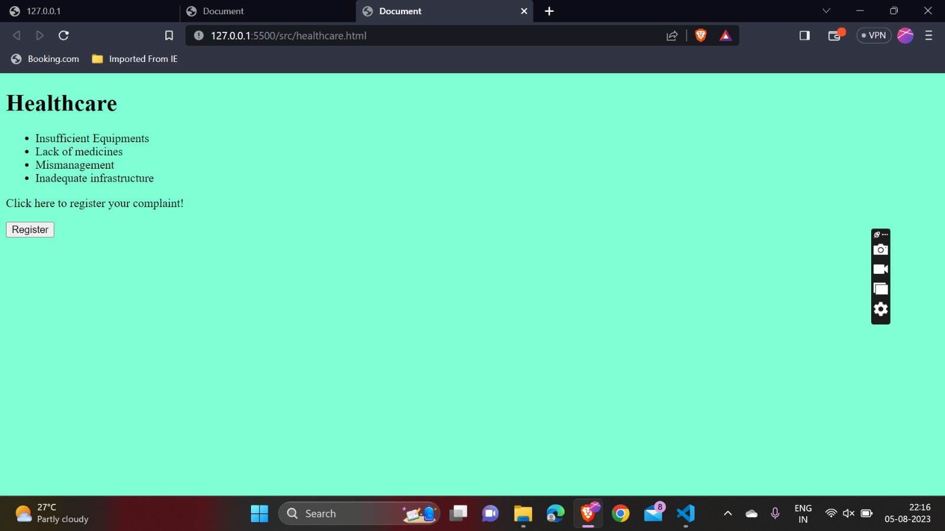

Slide 11
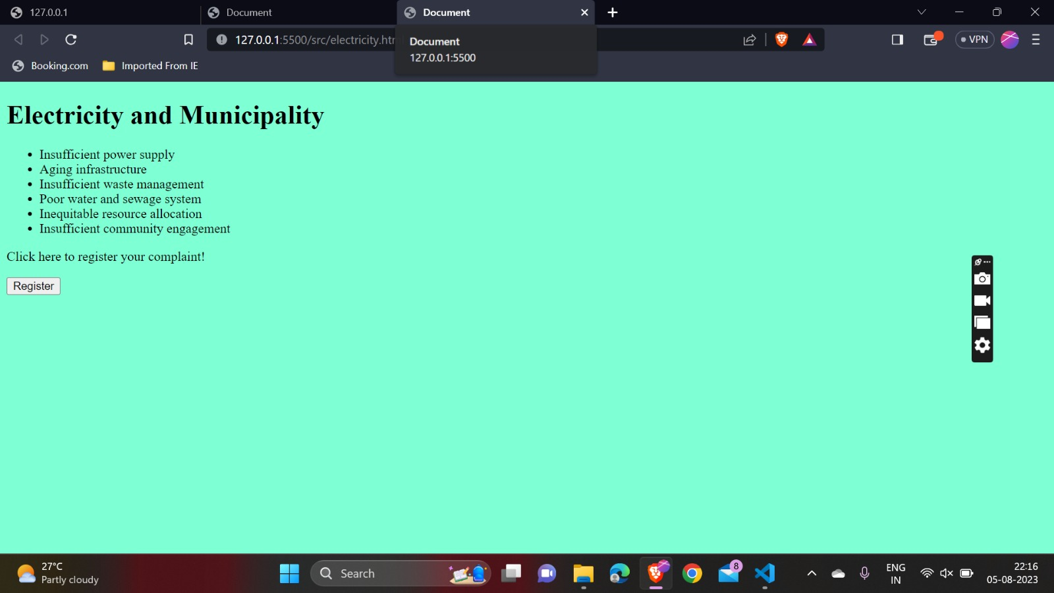

Slide 12
WOW FACTORS
The local government's responsiveness and vigilance are tracked through recorded resolution times for issues.
An integrated platform is employed to effectively address public concerns.

Slide 13
DEMO!

Slide 14
LEARNINGS DURING THE HACKATHON
Team collaboration
Time management
Adaptability
Networking
Domain knowledge

Slide 15
THANK YOU!!

